Slide 1

Chiang Rai Tourism with Advanced IT Solutions

Slide 2
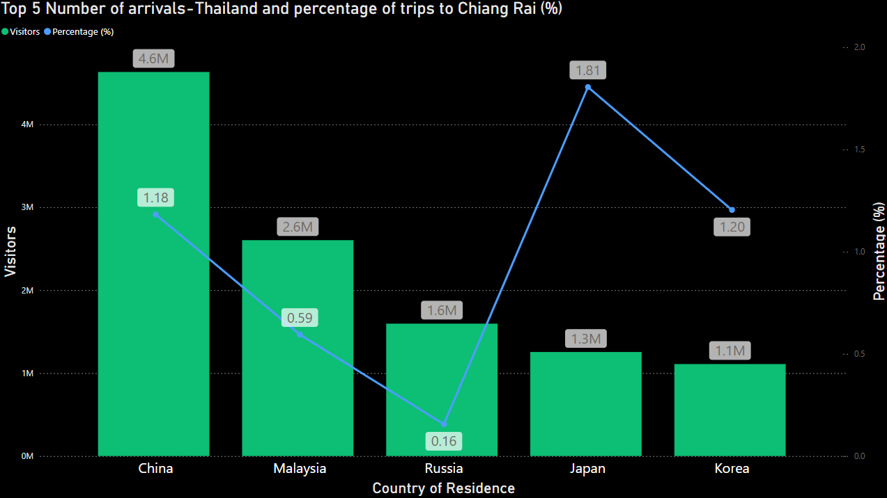
Top Countries Visiting Thailand and Their Percentage of Visits to Chiang Rai
Data from the year 2014 and prior

Slide 3
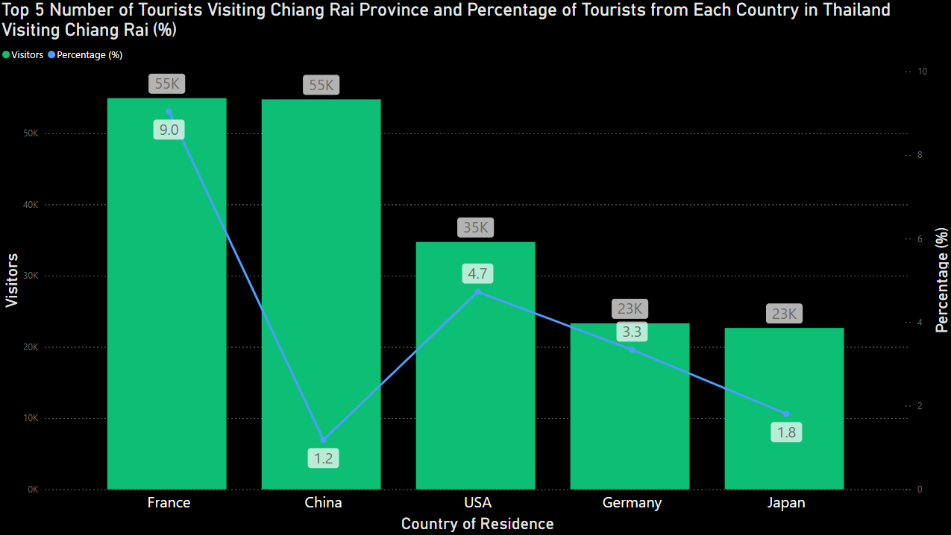
Top Source of International Visitors to Chiang Rai
Data from the year 2014 and prior

Slide 4
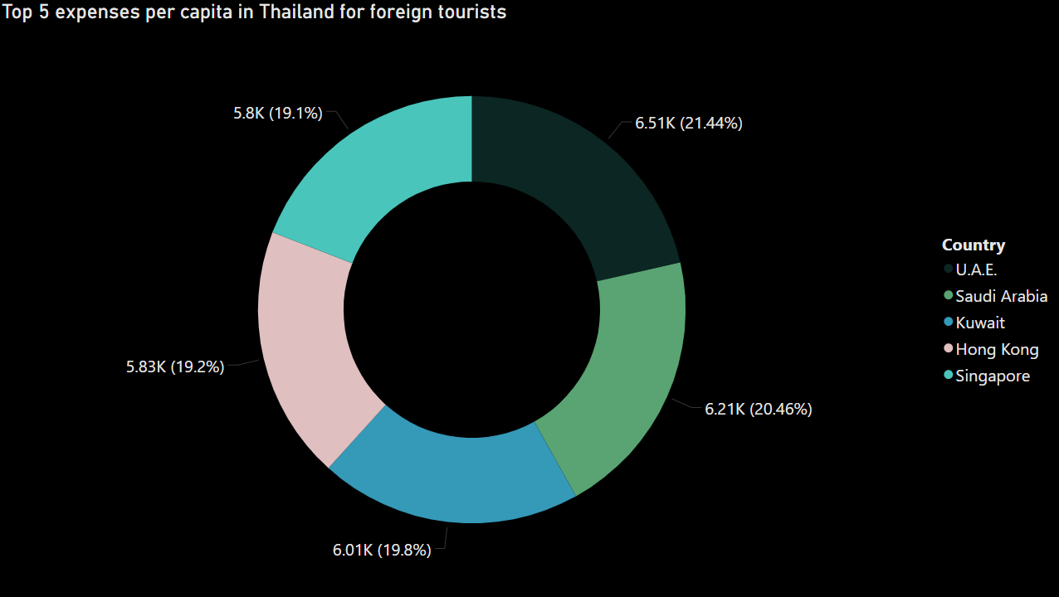
Countries with the Highest Per Capita Spending in Thailand
Data from the year 2014 and prior

Slide 5
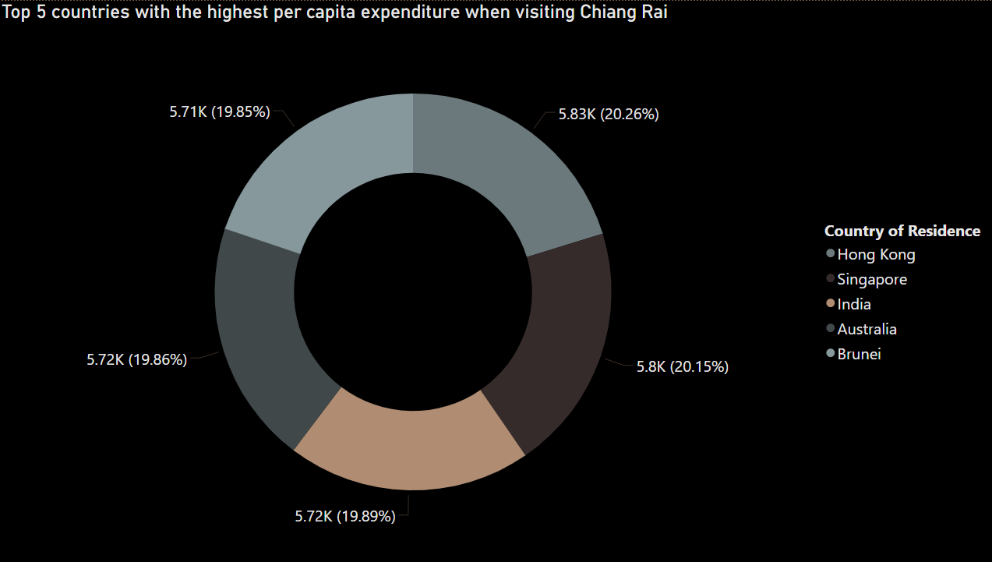
Countries with the Highest Per Capita Spending in Chiang Rai
Data from the year 2014 and prior

Slide 6
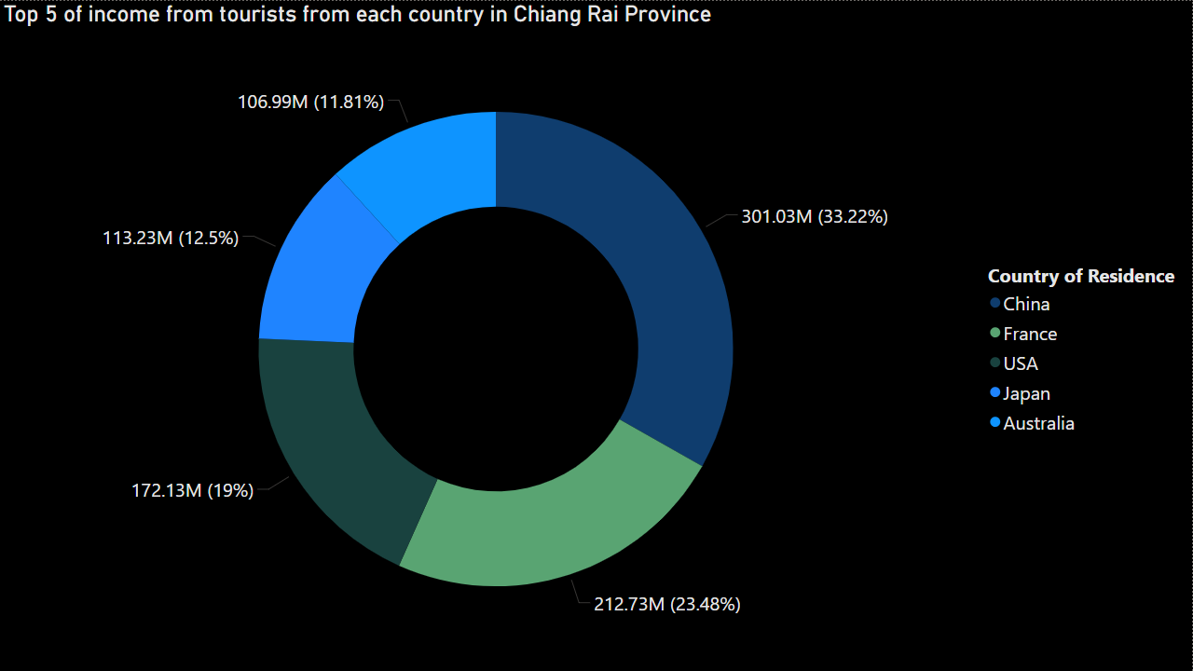
Top Revenue-Generating Countries in Chiang Rai
Data from the year 2014 and prior

Slide 7



From the previous slides, our target customer groups that can
Generate significant revenue for Chiang Rai include:
Highest Percentage of Visits
Highest Per Capita Spending
Highest Total Spending

Slide 8
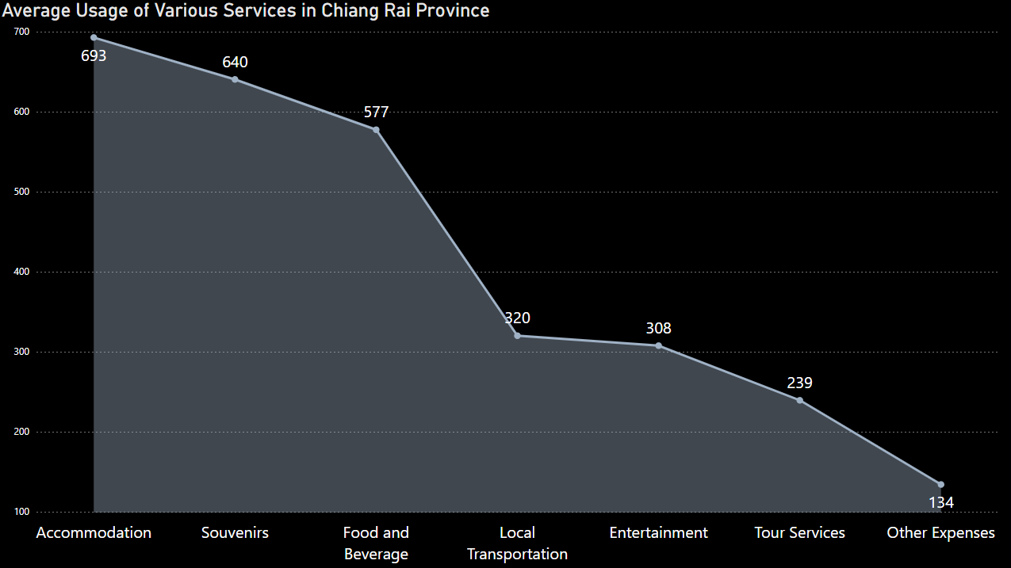
Invest in High-Expense Areas & Promote Spending in Lower-Cost Categories
Data from the year 2014 and prior

Slide 9
IT Solutions to Promote Tourism in Chiang Rai
Personalized Travel Recommendation App

Slide 10

What is Personalized Travel Recommendation App

Slide 11
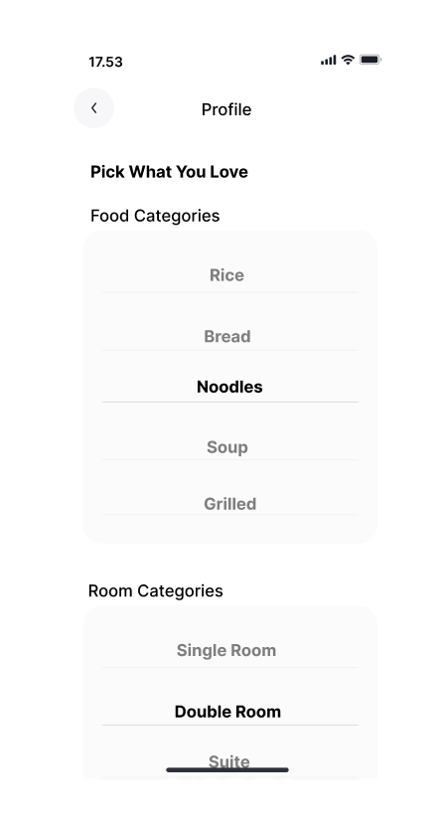
The app is designed to collect user preferences and securely store this data in the cloud.
The information is then analyzed to generate personalized recommendations that match
the user's needs and interests.

Slide 12
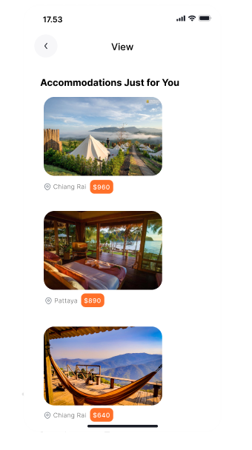
Once the user has made their selections, the app will analyze their preferences and choose
the most suitable options tailored to them.

Slide 13
Overview
Personalized Travel Recommendation App

Slide 14
Question ?

